Slide 1
Overview of Cloud Computing
Chapter - 1

Slide 2
Topics
Cloud Computing definition
Types of cloud
Public vs Private Cloud – Community Cloud – Hybrid Cloud
Cloud Services – Cloud models (IaaS, PaaS, SaaS)
Benefits and challenges of cloud computing
Business models
Major Players in Cloud Computing
Issues in Cloud

Slide 3
What is Cloud Computing?
Cloud Definition: The cloud in cloud computing provides the means through which everything from computing power to computing infrastructure, applications, business processes to personal collaboration — can be delivered to a user as a service wherever and whenever the user needs.
The cloud itself is a set of hardware, networks, storage, services, and interfaces that enable the delivery of computing as a service.
Cloud services include the delivery of software,infrastructure, and storage over the Internet (either as separate components or a complete platform) based on user demand.

Slide 4
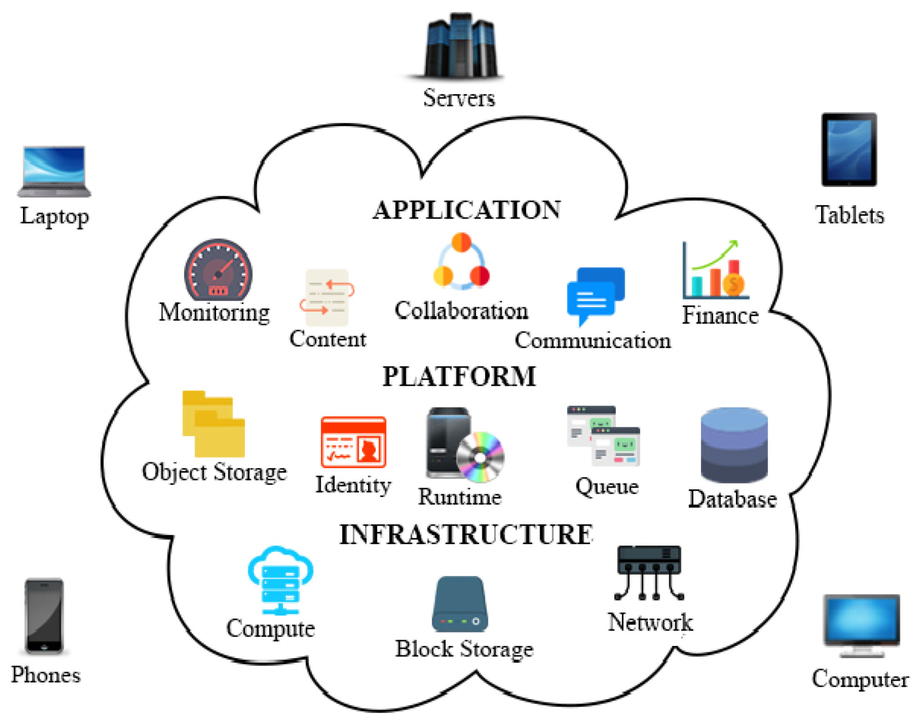

Slide 5
What is cloud computing ? … II
Cloud computing is a model for enabling ubiquitous, convenient, on-demand network access to a shared pool of configurable computing resources (e.g., networks, servers, storage, applications, and services) that can be rapidly provisioned and released with minimal management effort or service provider interaction.
Cloud computing refers to both the applications delivered as services over the Internet and the hardware and system software in the data centers that provide those services.

Slide 6
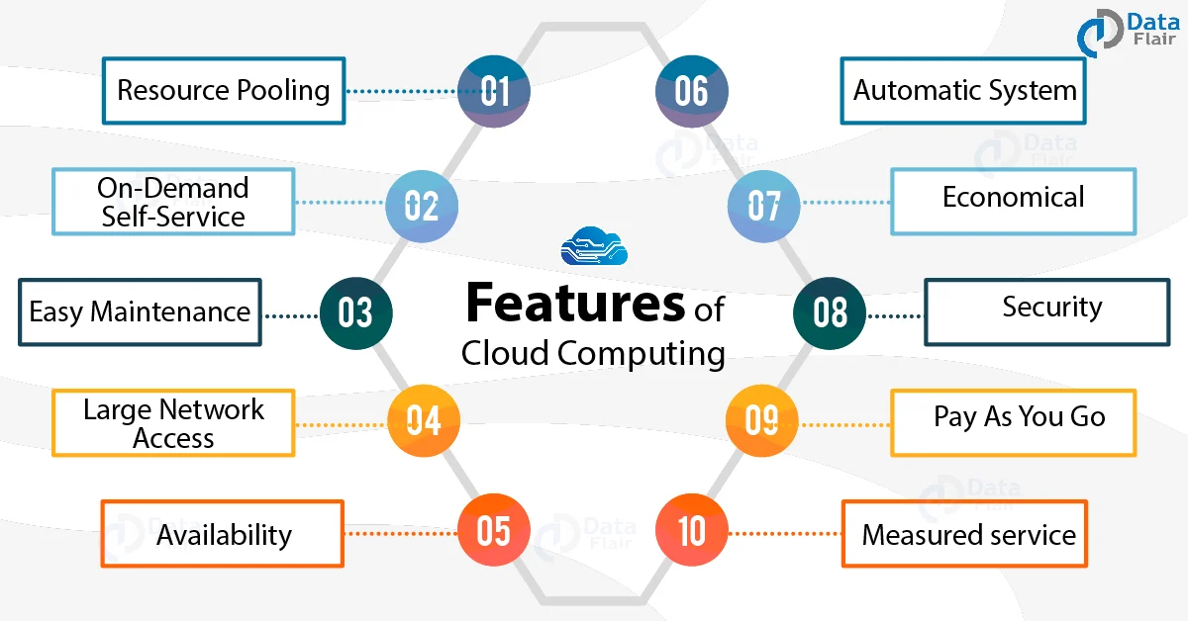
Why Cloud Computing ?

Slide 7
Why Cloud Computing ? … II
Elasticity and scalability
The service provider can‘t anticipate how customers will use the service.
One customer might use the service three times a year during peak selling seasons, whereas another might use it as a primary development platform for all of its applications.
Therefore, the service needs to be available all the time (7 days a week, 24 hours a day) and it has to be designed to scale upward for high periods of demand and downward for lighter ones.
Scalability also means that an application can scale when additional users are added and when the application requirements change.
This ability to scale is achieved by providing elasticity.

Slide 8
Why Cloud Computing ? … II
Self-service provisioning
Customers can easily get cloud services without going through a lengthy process.
The customer simply requests an amount of computing, storage, software, process, or other resources from the service provider.
While the on-demand provisioning capabilities of cloud services eliminate many time delays, an organization still needs to do its homework.
These services aren‘t free; needs and requirements must be determined before capability is automatically provisioned.

Slide 9
Why Cloud Computing ? … III
Application programming interfaces (APIs)
Cloud services need to have standardized APIs.
These interfaces provide the instructions on how two application or data sources can communicate with each other.
A standardized interface lets the customer more easily link a cloud service, such as a customer relationship management system with a financial accounts management system, without having to resort to custom programming.

Slide 10
Why Cloud Computing ? … IV
Billing and metering of services
A cloud environment needs a built-in service that bills customers. And, of course, to calculate that bill, usage has to be metered (tracked).
Even free cloud services (such as Google‘s Gmail or Zoho‘s Internet-based office applications) are metered.
In addition to these characteristics, cloud computing must have two overarching requirements to be effective:
A comprehensive approach to service management
A well-defined process for security management

Slide 11
Why Cloud Computing ? … V
Performance monitoring and measuring
A cloud service provider must include a service management environment.
A service management environment is an integrated approach for managing the physical environments and IT systems.
This environment must be able to maintain the required service level for that Organization.
In other words, service management has to monitor and optimize the service or sets of services.
Service management has to consider key issues, such as performance of the overall system, including security and performance.

Slide 12
Why Cloud Computing ? … VI
Security
Many customers must take a leap of faith to trust that the cloud service is safe.
Turning over critical data or application infrastructure to a cloud-based service provider requires making sure that the information can‘t be accidentally accessed by another company (or maliciously accessed by a hacker).
Many companies have compliance requirements for securing both internal and external information.
Without the right level of security, one might not be able to use a provider‘s offerings.

Slide 13
Types of cloud
Cloud computing is offered in different forms:
Public clouds: in a public cloud, a business rents the capability and they pay for what they use on-demand. Example- Amazon, Google and IBM
Private clouds: cloud computing environment in which all hardware and software resources are dedicated exclusively to, and accessible only by, a single customer
Hybrid clouds: it is combination of public and private making advantage of both
Community cloud: Allows sharing of resources costing less for resource usage

Slide 14
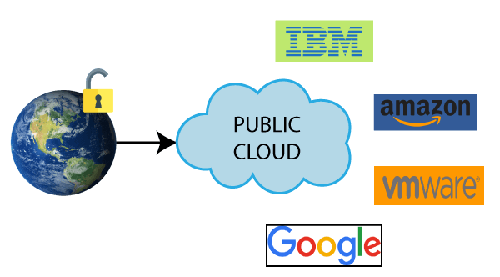
Public cloud
Public Cloud is an IT model where on-demand computing services and infrastructure are managed by a third-party provider and shared with multiple organizations using the public Internet.

Slide 15
Advantages of Public Cloud
1) Low Cost
Public cloud has a lower cost than private, or hybrid cloud, as it shares the same resources with a large number of consumers.
2) Location Independent
Public cloud is location independent because its services are offered through the internet.
3) Save Time
In Public cloud, the cloud service provider is responsible for the manage and maintain data centers in which data is stored, so the cloud user can save their time to establish connectivity, deploying new products, release product updates, configure, and assemble servers.
4) Scalability and reliability
Public cloud offers scalable (easy to add and remove) and reliable (24*7 available) services to the users at an affordable cost.

Slide 16
Disadvantages of Public Cloud
1) Low Security
Public Cloud is less secure because resources are shared publicly.
2) Performance
In the public cloud, performance depends upon the speed of internet connectivity.
3) Less customizable
Public cloud is less customizable than the private cloud.

Slide 17
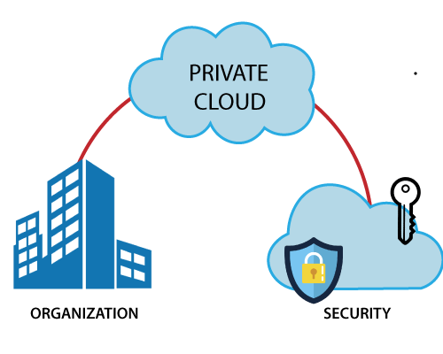
Private cloud
In private clouds, a business essentially turns its IT environment into a cloud and uses it to deliver services to their users.

Slide 18
Private cloud
Private cloud is also known as an internal cloud or corporate cloud.
Private cloud provides computing services to a private internal network (within the organization) and selected users instead of the general public.
Private cloud provides a high level of security and privacy to data through firewalls and internal hosting. It also ensures that operational and sensitive data are not accessible to third-party providers.
HP Data Centers, Microsoft, Elastra-private cloud, and Ubuntu are the example of a private cloud.

Slide 19
Advantages of Private cloud
1) More Control
Private clouds have more control over their resources and hardware than public clouds because it is only accessed by selected users.
2) Security & privacy
Security & privacy are one of the big advantages of cloud computing. Private cloud improved the security level as compared to the public cloud.
3) Improved performance
Private cloud offers better performance with improved speed and space capacity.

Slide 20
Disadvantages of Private Cloud
1) High cost
The cost is higher than a public cloud because set up and maintain hardware resources are costly.
2) Restricted area of operations
As we know, private cloud is accessible within the organization, so the area of operations is limited.
3) Limited scalability
Private clouds are scaled only within the capacity of internal hosted resources.
4) Skilled people
Skilled people are required to manage and operate cloud services.

Slide 21
Hybrid cloud
Hybrid cloud is a combination of public and private clouds.
Hybrid cloud = public cloud + private cloud
The main aim to combine these cloud (Public and Private) is to create a unified, automated, and well-managed computing environment.
In the Hybrid cloud, non-critical activities are performed by the public cloud and critical activities are performed by the private cloud.
Mainly, a hybrid cloud is used in finance, healthcare, and Universities.
The best hybrid cloud provider companies are Amazon, Microsoft, Google, Cisco, and NetApp.

Slide 22
Advantages of Hybrid Cloud
1) Flexible and secure
It provides flexible resources because of the public cloud and secure resources because of the private cloud.
2) Cost effective
Hybrid cloud costs less than the private cloud. It helps organizations to save costs for both infrastructure and application support.
3) Cost Optimization
It offers the features of both the public as well as the private cloud. A hybrid cloud is capable of adapting to the demands that each company needs for space, memory, and system.

Slide 23
Disadvantages of Hybrid Cloud
1) Networking issues
In the Hybrid Cloud, networking becomes complex because of the private and the public cloud.
2) Infrastructure Compatibility
Infrastructure compatibility is the major issue in a hybrid cloud. With dual-levels of infrastructure, a private cloud controls the company, and a public cloud does not, so there is a possibility that they are running in separate stacks.
3) Reliability
The reliability of the services depends on cloud service providers.

Slide 24
Community Cloud
Community cloud is a cloud infrastructure that allows systems and services to be accessible by a group of several organizations to share the information.
It is owned, managed, and operated by one or more organizations in the community, a third party, or a combination of them.

Slide 25
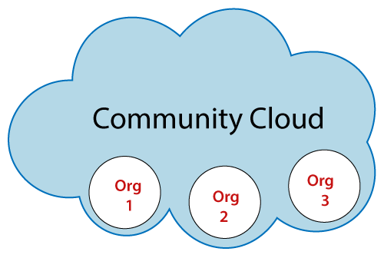
Community Cloud

Slide 26
Advantages of Community Cloud
Cost effective
Community cloud is cost effective because the whole cloud is shared between several organizations or a community.
Flexible and Scalable
The community cloud is flexible and scalable because it is compatible with every user. It allows the users to modify the documents as per their needs and requirement.
Security
Community cloud is more secure than the public cloud but less secure than the private cloud.
Sharing infrastructure
Community cloud allows us to share cloud resources, infrastructure, and other capabilities among various organizations.

Slide 27
Disadvantages of Community Cloud
Community cloud is not a good choice for every organization
Slow adoption to data
The fixed amount of data storage and bandwidth is shared among all community members
Community Cloud is costly than the public cloud
Sharing responsibilities among organizations is difficult.

Slide 28
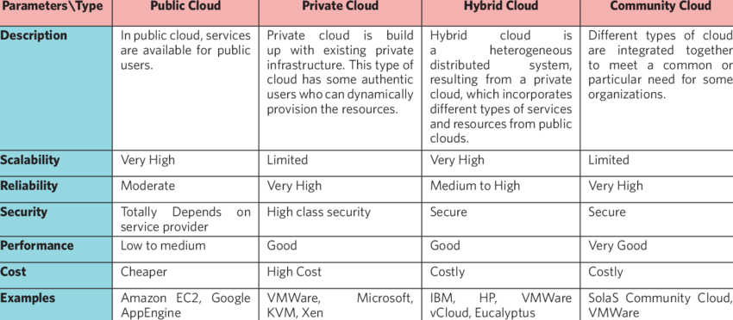

Slide 29
Cloud services / Business models
Cloud services are infrastructure, platforms, or software that are hosted by third-party providers and made available to users through the internet.
They are basically divided into 5 parts:
Software as a service (SaaS)
Platform as a service (PaaS)
Infrastructure as a service (IaaS)
Anything/Everything as a service (XaaS)
Function as a Service (FaaS)

Slide 30
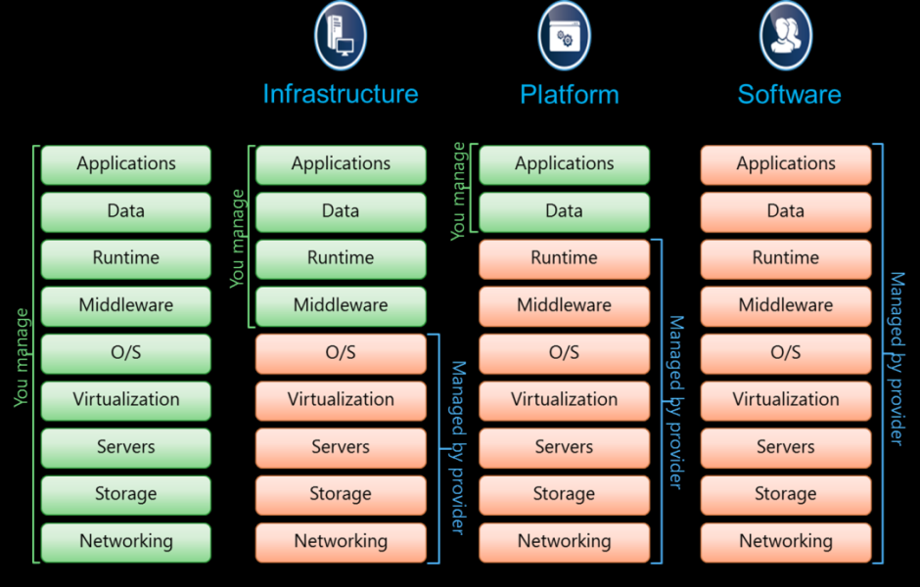

Slide 31
Software as a Service(SaaS)
Software-as-a-Service (SaaS) is a way of delivering services and applications over the Internet.
Instead of installing and maintaining software, we simply access it via the Internet, freeing ourselves from the complex software and hardware management.
It removes the need to install and run applications on our own computers or in the data centers eliminating the expenses of hardware as well as software maintenance.

Slide 32
Software as a Service(SaaS) .. II
SaaS provides a complete software solution that you purchase on a pay-as-you-go basis from a cloud service provider.
Most SaaS applications can be run directly from a web browser without any downloads or installations required.
The SaaS applications are sometimes called Web-based software, on-demand software, or hosted software

Slide 33
Advantages of SaaS
Cost-Effective: Pay only for what you use.
Reduced time: Users can run most SaaS apps directly from their web browser without needing to download and install any software.
Accessibility: We can Access app data from anywhere.
Automatic updates: Rather than purchasing new software, customers rely on a SaaS provider to automatically perform the updates.

Slide 34
Disadvantages of Saas
Limited customization: SaaS solutions are typically not as customizable as on-premises software, meaning that users may have to work within the constraints of the SaaS provider’s platform and may not be able to tailor the software to their specific needs.
Dependence on internet connectivity: SaaS solutions are typically cloud-based, which means that they require a stable internet connection to function properly.
Security concerns: SaaS providers are responsible for maintaining the security of the data stored on their servers, but there is still a risk of data breaches or other security incidents.
Limited control over data: SaaS providers may have access to a user’s data, which can be a concern for organizations that need to maintain strict control over their data for regulatory or other reasons.

Slide 35
Platform as a Service
PaaS is a category of cloud computing that provides a platform and environment to allow developers to build applications and services over the internet.
PaaS services are hosted in the cloud and accessed by users simply via their web browser.
A PaaS provider hosts the hardware and software on its own infrastructure.

Slide 36
Platform as a Service (PAAS) ..II
PaaS makes users free from having to install in-house hardware and software to develop or run a new application. Thus, the development and deployment of the application take place independent of the hardware.
The consumer does not manage or control the underlying cloud infrastructure including network, servers, operating systems, or storage, but has control over the deployed applications and possibly configuration settings for the application-hosting environment.

Slide 37
Advantages of PaaS
Simple and convenient for users: It provides much of the infrastructure and other IT services, which users can access anywhere via a web browser.
Cost-Effective: It charges for the services provided on a per-use basis thus eliminating the expenses one may have for on-premises hardware and software.
Efficiently managing the lifecycle: It is designed to support the complete web application lifecycle: building, testing, deploying, managing, and updating.
Efficiency: It allows for higher-level programming with reduced complexity thus, the overall development of the application can be more effective

Slide 38
Disadvantages of Paas
Limited control over infrastructure: PaaS providers typically manage the underlying infrastructure and take care of maintenance and updates, but this can also mean that users have less control over the environment and may not be able to make certain customizations.
Dependence on the provider: Users are dependent on the PaaS provider for the availability, scalability, and reliability of the platform, which can be a risk if the provider experiences outages or other issues.
Limited flexibility: PaaS solutions may not be able to accommodate certain types of workloads or applications, which can limit the value of the solution for certain organizations.

Slide 39
Infrastructure as a Service (IAAS)
Infrastructure as a service (IaaS) is a service model that delivers computer infrastructure on an outsourced basis to support various operations.
Typically IaaS is a service where infrastructure is provided as outsourcing to enterprises such as networking equipment, devices, database, and web servers.
It is also known as Hardware as a Service (HaaS). IaaS customers pay on a per-user basis, typically by the hour, week, or month.
Some providers also charge customers based on the amount of virtual machine space they use.

Slide 40
Advantages of IaaS
Cost-Effective: Eliminates capital expense and reduces ongoing cost and IaaS customers pay on a per-user basis, typically by the hour, week, or month.
Website hosting: Running websites using IaaS can be less expensive than traditional web hosting.
Security: The IaaS Cloud Provider may provide better security than your existing software.
Maintenance: There is no need to manage the underlying data center or the introduction of new releases of the development or underlying software. This is all handled by the IaaS Cloud Provider.

Slide 41
Disadvantages of IaaS
Limited control over infrastructure: IaaS providers typically manage the underlying infrastructure and take care of maintenance and updates, but this can also mean that users have less control over the environment and may not be able to make certain customizations.
Security concerns: Users are responsible for securing their own data and applications, which can be a significant undertaking.
Limited access: Cloud computing may not be accessible in certain regions and countries due to legal policies.

Slide 42
Anything as a Service
It is also known as Everything as a Service. Most of the cloud service providers nowadays offer anything as a service that is a compilation of all of the above services including some additional services.

Slide 43
Function as a Service
FaaS is a type of cloud computing service.
It provides a platform for its users or customers to develop, compute, run and deploy the code or entire application as functions.
It allows the user to entirely develop the code and update it at any time without worrying about the maintenance of the underlying infrastructure.
The developed code can be executed with response to the specific event.

Slide 44
Benefits of cloud computing
Scalability: Cloud computing allows you to easily scale your resources up or down based on your needs.
Cost Savings: Cloud computing eliminates the need for upfront investments in hardware, software licenses, and infrastructure.
Accessibility and Remote Work: Cloud services can be accessed from anywhere with an internet connection, enabling remote work and collaboration.
Reliability and Availability: Cloud computing providers typically offer robust service level agreements (SLAs) guaranteeing high availability and uptime.

Slide 45
Benefits of cloud computing
Security: Cloud providers invest heavily in security measures to protect their infrastructure and customer data.
Data Backup and Recovery: Cloud computing offers automated and reliable data backup and recovery solutions at various locations.
Innovation and Agility: Cloud services enable rapid deployment of applications and services.
Green Computing: Cloud computing promotes environmentally friendly practices.

Slide 46
challenges of cloud computing
Performance
Migration
Interoperability and Portability
Reliability and High Availability
Hybrid-Cloud Complexity
Mobile interactive applications
Security
Cost Management
Lack of expertise
Internet Connectivity
Control or Governance
Compliance
Multiple Cloud management

Slide 47
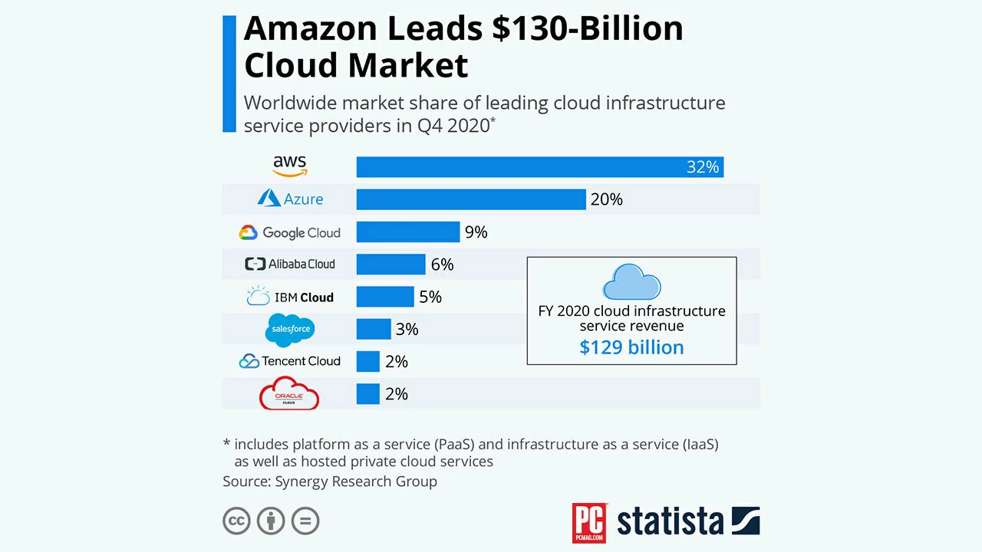
Major Players in Cloud Computing

Slide 48
Issues in Cloud
1. Privacy Concerns with a Third Party
How do you know that it’s safe and secure?
In reality, even if providers are doing their best to secure data, it can still be hacked
The best plan of attack is to not perform mission-critical work or work that is highly sensitive on a cloud platform without extensive security controls managed by your organization

Slide 49
Issues in Cloud ..II
2. Compliance
There are many regulations in places related to data and hosting.
To comply with regulations (Federal Information Security Management Act, Health Insurance Portability and Accountability Act, etc.) the user may have to adopt deployment modes that are expensive.

Slide 50
Issues in Cloud ..III
3. Sustainability
This issue refers to minimizing the effect of cloud computing on the environment.
Citing the server’s effects on the environmental effects of cloud computing, in areas where climate favors natural cooling and renewable electricity is readily available, the countries with favorable conditions, such as Finland, Sweden, and Switzerland are trying to attract cloud computing data centers.
But other than nature’s favors, would these countries have enough technical infrastructure to sustain the high-end clouds?

Slide 51
Issues in Cloud ..IV
4. Lack of resources/skilled expertise
One of the major issues that companies and enterprises are going through today is the lack of resources and skilled employees.
Every second organization is seeming interested or has already been moved to cloud services. That’s why the workload in the cloud is increasing so the cloud service hosting companies need continuous rapid advancement.
Due to these factors, organizations are having a tough time keeping up to date with the tools. As new tools and technologies are emerging every day so more skilled/trained employees need to grow. These challenges can only be minimized through additional training of IT and development staff.

Slide 52
Issues in Cloud ..V
5. Other issues
Availability
Identification
Authentication
Authorization
Auditing

Slide 53

That's all folks for this chapter !!!!

